Slide 1
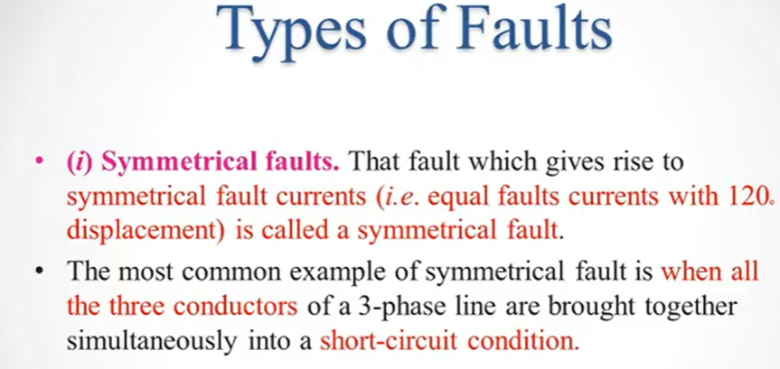
TYPES OF FAULTS
Symmetrical Faults
UnSymmetrical Faults
In this case symmetrical fault currents occur (or equal fault current occurs at 120 degree phase difference

Slide 2
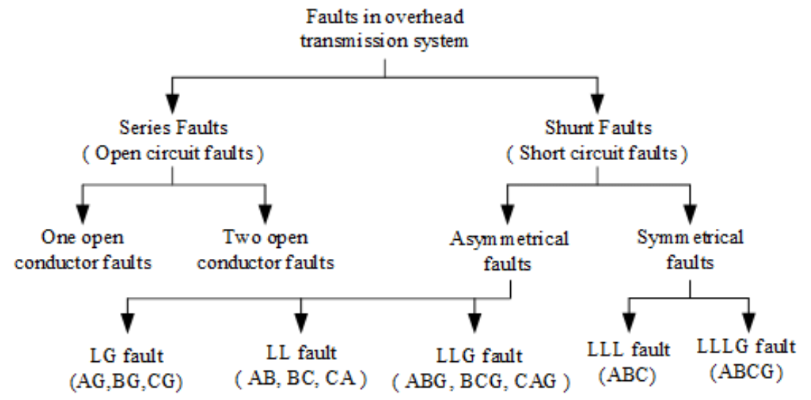

Slide 3
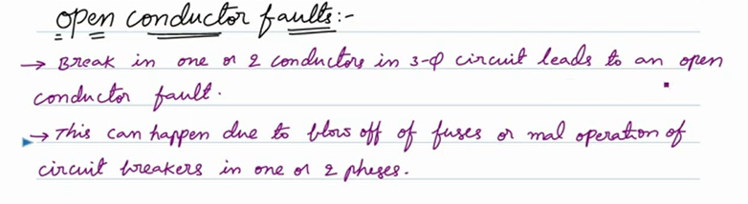
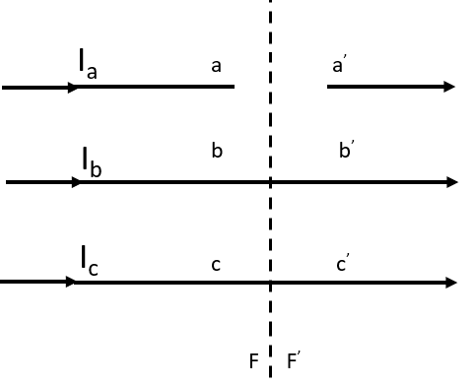
ONE OPEN CONDUCTOR FAULTS OR
ONE CONDUCTOR OPEN FAULT
It is a Series type fault or fault occurs in the series of Transmission Line.
In Figure below three phase transmission line, and conductor a is open-circuited due to any reason such as mall function of relay, mall function of fuse, or due to circuit breaker conductor a is open circuited.
$$Line Currents before a fault is denoted as I_{a},I_{b},I_{c}$$
$$Voltage at terminal a of V_{a}=V_{a} −V_{a}^{′}$$
$$Voltage at terminal b of V_{b}=V_{b} −V_{b}^{′}$$
$$Voltage at terminal c of V_{c}=V_{c} −V_{c}^{′}$$

Slide 4
ONE OPEN CONDUCTOR FAULTS OR
ONE CONDUCTOR OPEN FAULT
$$Voltage at terminal a of V_{a}=V_{a} −V_{a}^{′}$$
$$Voltage at terminal b of V_{b}=V_{b} −V_{b}^{′} =0$$
$$Voltage at terminal c of V_{c}=V_{c} −V_{c}^{′}$$

Slide 5
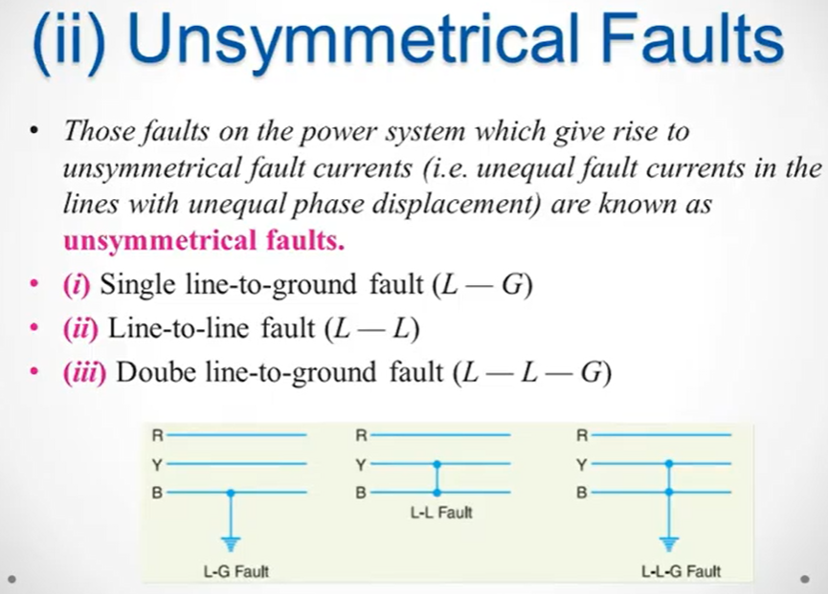

Slide 6
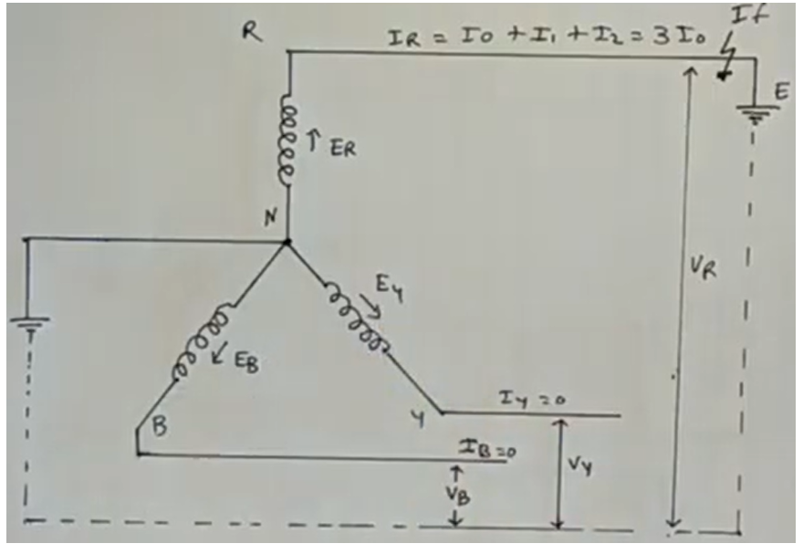
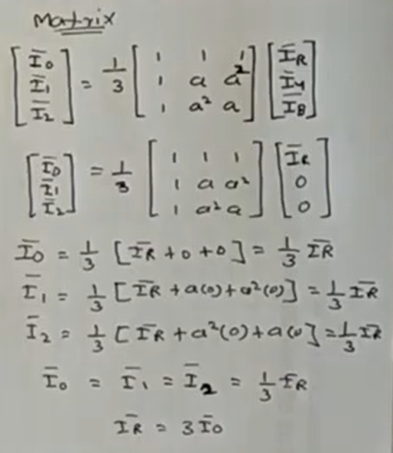
Single Line TO Ground Fault
In this case any line of 3-phase is short is called as Single-Line-To-Ground Fault.
Calculate the Fault current formula and Draw the Sequence Network

Slide 7
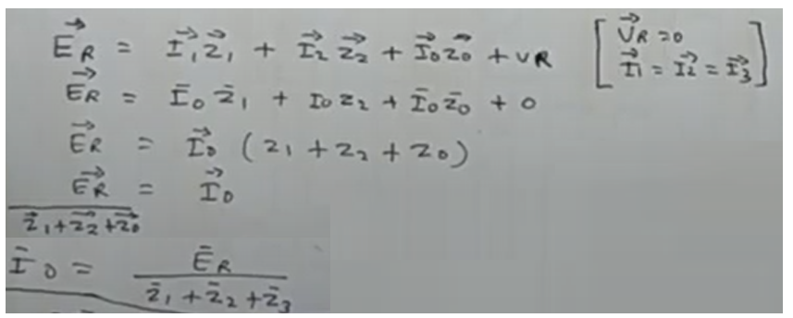
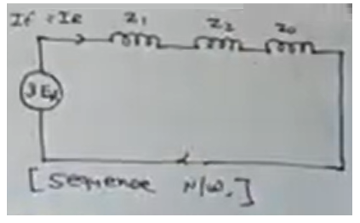
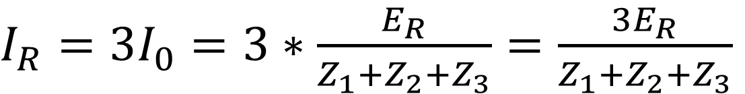
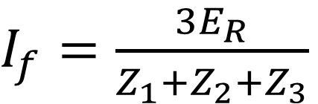
Single Line TO Ground Fault
So, Fault current at R is I_{R} = 3I₀
$I_{R}=3I_{0}=3∗\frac{E_{R}}{Z_{1}+Z_{2}+Z_{3}}=\frac{3E_{R}}{Z_{1}+Z_{2}+Z_{3}}$
$I_{f}=\frac{3E_{R}}{Z_{1}+Z_{2}+Z_{3}}$

Slide 8
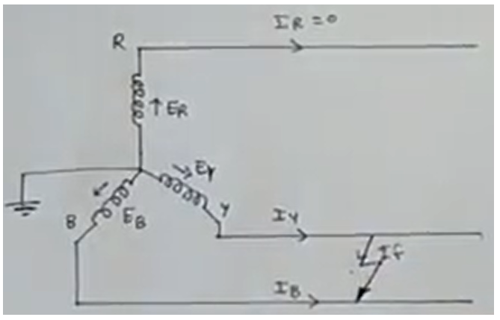
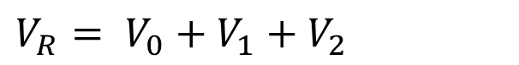
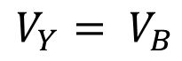
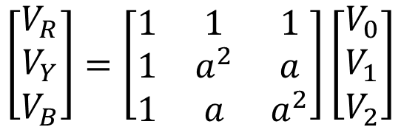
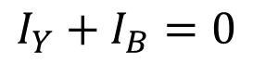

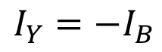
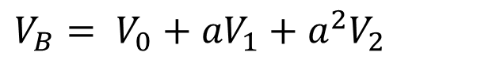
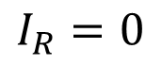
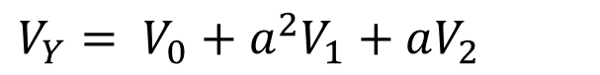
Line TO Line Fault
In this case any 2 line of 3-phase is short is called as Line-Line Fault.
Calculate the Fault current formula and Draw the Sequence Network.
$$V_{Y}= V_{B}$$
$$I_{R}=0$$
$$I_{Y}=−I_{B}$$
$$I_{Y}+I_{B}=0$$
$$\left[\begin{matrix}V_{R} \\ V_{Y} \\ V_{B}\end{matrix}\right]=\left[\begin{matrix}1 & 1 & 1 \\ 1 & a^{2} & a \\ 1 & a & a^{2}\end{matrix}\right]\left[\begin{matrix}V_{0} \\ V_{1} \\ V_{2}\end{matrix}\right]$$
$V_{R}= V_{0}+V_{1}+V_{2}$
$V_{Y}= V_{0}+a^{2}V_{1}+aV_{2}$
$V_{B}= V_{0}+{aV}_{1}+{a^{2}V}_{2}$
$$V_{Y}=V_{B}$$

Slide 9
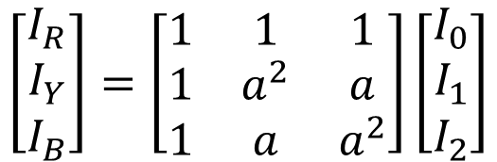


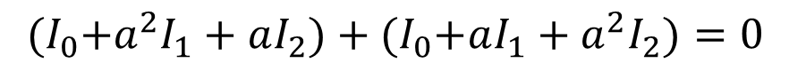

Line TO Line Fault
In this case any 2 line of 3-phase is short is called as Line-Line Fault.
Calculate the Fault current formula and Draw the Sequence Network.
$$V_{Y}=V_{B}$$
$$V_{0}+a^{2}V_{1}+aV_{2}=V_{0}+{aV}_{1}+{a^{2}V}_{2}$$
$$a^{2}V_{1}−aV_{1}={a^{2}V}_{2}−aV_{2}$$
$${V_{1}(a}^{2}−a)=V_{2}(a^{2} −a)$$
$$V_{1}=V_{2}$$
$$\left[\begin{matrix}I_{R} \\ I_{Y} \\ I_{B}\end{matrix}\right]=\left[\begin{matrix}1 & 1 & 1 \\ 1 & a^{2} & a \\ 1 & a & a^{2}\end{matrix}\right]\left[\begin{matrix}I_{0} \\ I_{1} \\ I_{2}\end{matrix}\right]$$
$$I_{Y}+I_{B}=0$$
$${(I}_{0}+a^{2}I_{1}+aI_{2})+{(I}_{0}+aI_{1}+a^{2}I_{2})=0$$
$${2I}_{0}+a^{2}I_{1}+aI_{2}+aI_{1}+a^{2}I_{2}=0$$
$${2I}_{0}+{(a}^{2}+a)(I_{1}+I_{2})+{(a}^{2}+a)(I_{1}+I_{2})=0$$
$${2I}_{0}+{(a}^{2}+a)\left(I_{1}+I_{2}\right)=0$$

Slide 10
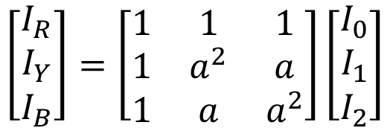


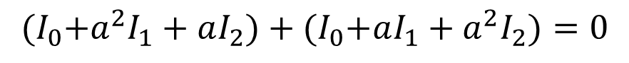

Line TO Line Fault
$$V_{Y}=V_{B}$$
$$V_{0}+a^{2}V_{1}+aV_{2}=V_{0}+{aV}_{1}+{a^{2}V}_{2}$$
$$a^{2}V_{1}−aV_{1}={a^{2}V}_{2}−aV_{2}$$
$${V_{1}(a}^{2}−a)=V_{2}(a^{2} −a)$$
$$V_{1}=V_{2}$$
$$\left[\begin{matrix}I_{R} \\ I_{Y} \\ I_{B}\end{matrix}\right]=\left[\begin{matrix}1 & 1 & 1 \\ 1 & a^{2} & a \\ 1 & a & a^{2}\end{matrix}\right]\left[\begin{matrix}I_{0} \\ I_{1} \\ I_{2}\end{matrix}\right]$$
$$I_{Y}+I_{B}=0$$
$${(I}_{0}+a^{2}I_{1}+aI_{2})+{(I}_{0}+aI_{1}+a^{2}I_{2})=0$$
$${2I}_{0}+a^{2}I_{1}+aI_{2}+aI_{1}+a^{2}I_{2}=0$$
I₀ is zero, because no current flow in neutral, due to line-to-line short circuit
$${2I}_{0}+{(a}^{2}+a)(I_{1}+I_{2})+{(a}^{2}+a)(I_{1}+I_{2})=0$$
$$0+{(a}^{2}+a)\left(I_{1}+I_{2}\right)=0$$
$${2I}_{0}+{(a}^{2}+a)\left(I_{1}+I_{2}\right)=0$$
$${(a}^{2}+a)\left(I_{1}+I_{2}\right)=0$$
$$\left(I_{1}+I_{2}\right)=0$$

Slide 11
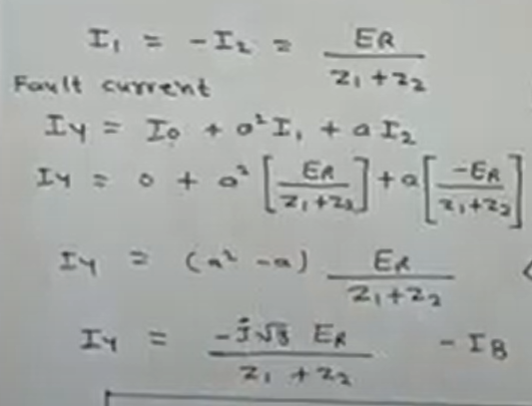
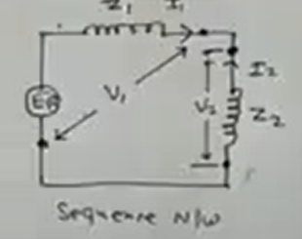
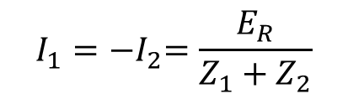




Line TO Line Fault
Now draw a sequence network
$$\left(I_{1}+I_{2}\right)=0$$
$$V_{1}=V_{2}$$
$$I_{1}={−I}_{2}=\frac{E_{R}}{Z_{1}+Z_{2}}$$
$$\left(I_{1}+I_{2}\right)=0$$
$$I_{Y}= I_{0}+ a^{2}I_{1}+aI_{2}$$
$I_{Y}=0+ a^{2}\left(\frac{E_{R}}{Z_{1}+Z_{2}}\right)+a\left(\frac{{−E}_{R}}{Z_{1}+Z_{2}}\right)$ $=0+ a^{2}\left(\frac{E_{R}}{Z_{1}+Z_{2}}\right)−a\left(\frac{E_{R}}{Z_{1}+Z_{2}}\right)=(a^{2}−a)\left(\frac{E_{R}}{Z_{1}+Z_{2}}\right)$

Slide 13
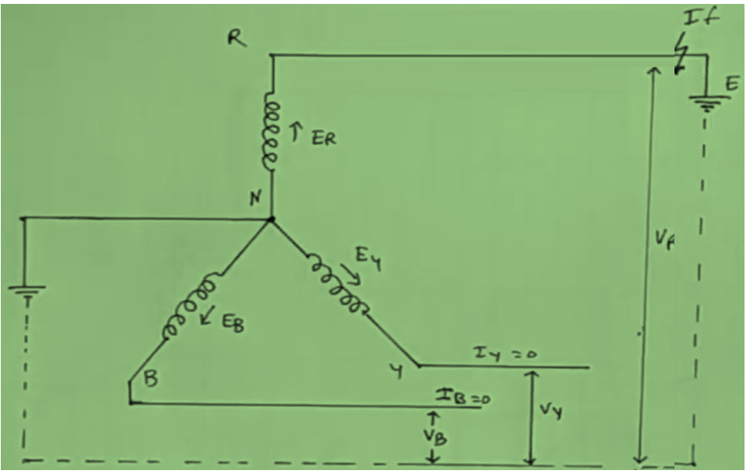
https://www.youtube.com/watch?v=zY7zKS3i4K0
In this Figure Fault occur on Red phase, and than R-phase is short with ground

Slide 14
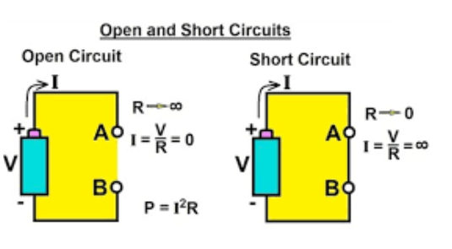
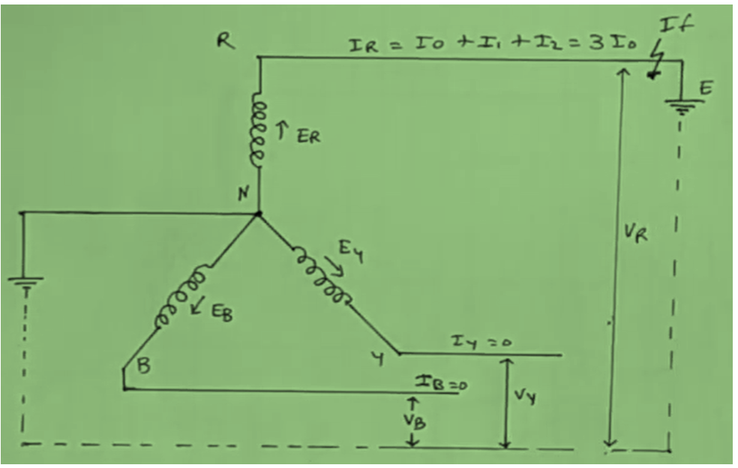
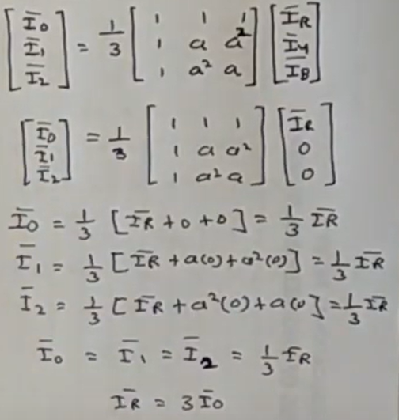
Short circuit occur at R-Phase, than current is infinity and voltage of V_{R} is = 0
EMF of R-Phase
EMF of Y-Phase
EMF of B-Phase
Sequence components zero, +ve and –ve components
These both line are open, so current can not flow, so I_{y} = 0 and I_{B} = 0

Slide 15
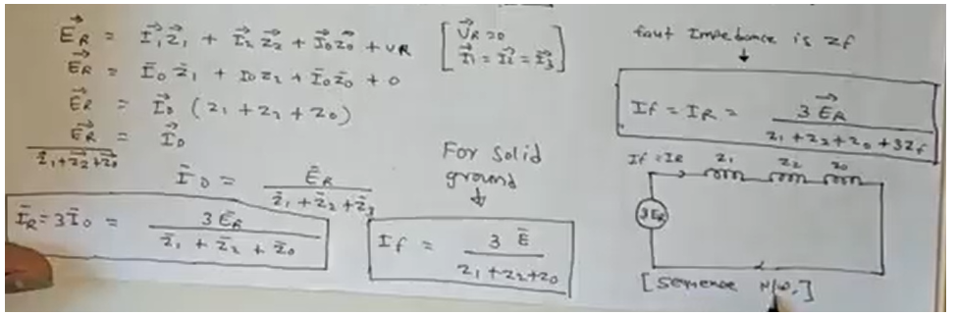

Slide 16
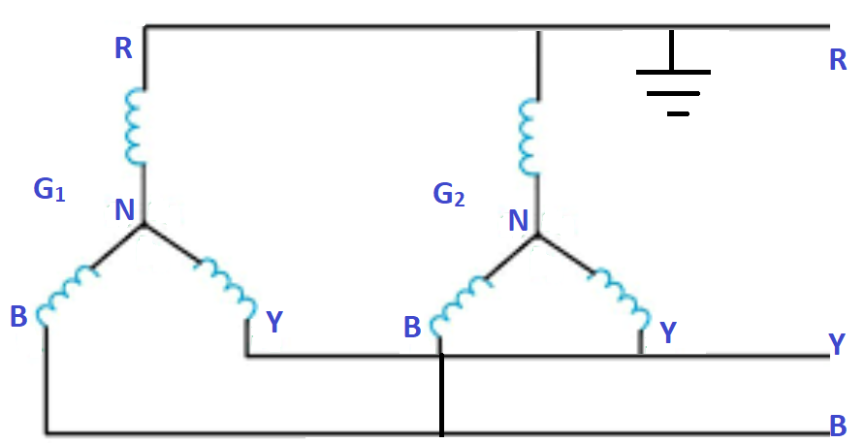
Single Line TO Ground Fault
Q: 25 MVA, 11KV, 3φ, 50 Hz. It is parallel with another identical generator. The positive sequence reactance is (X₁)= 20%, negative sequence reactance is (X₂)= 10%, and zero sequence reactance is (X₀)= 15% . If a line to ground short circuit occurs in the common bus bar R. Calculate the fault current. Case1: Ungrounded Neutral

Slide 17
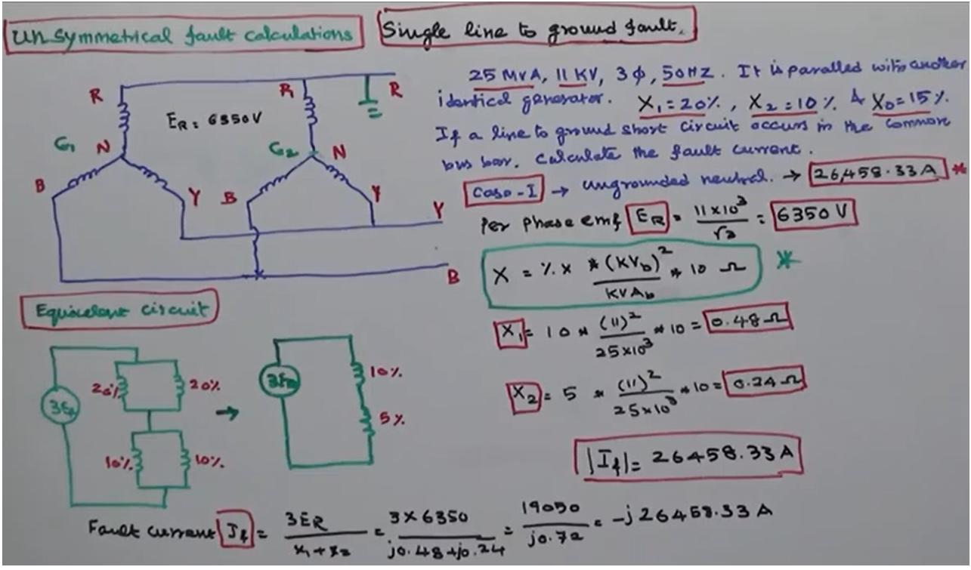
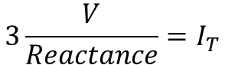
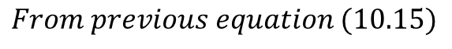
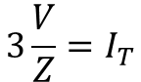
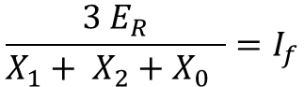
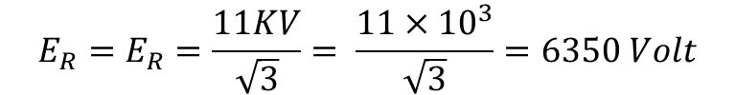
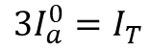
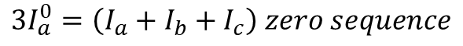
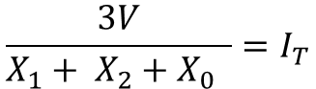
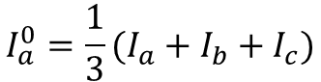
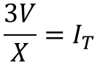
Single Line TO Ground Fault
SOLUTION: Calculate the Per-Phase EMF, EMF at R-phase, EMF at Y phase than EMF at B phase
$$E_{R}=E_{R}=\frac{11KV}{\sqrt{3}}= \frac{11×{10}^{3}}{\sqrt{3}}=6350 Volt$$
$$From previous equation (10.15)$$
$$I_{a}^{0}=\frac{1}{3}(I_{a}+I_{b}+I_{c})$$
$$\frac{3 E_{R}}{X_{1}+ X_{2}+X_{0} }=I_{f}$$
$${3I}_{a}^{0}=\left(I_{a}+I_{b}+I_{c}\right) zero sequence$$
$${3I}_{a}^{0}=I_{T}$$
$$3\frac{V}{Z}=I_{T}$$
$$3\frac{V}{Reactance}=I_{T}$$
$$\frac{3V}{X}=I_{T}$$
$$\frac{3V}{X_{1}+ X_{2}+X_{0} }=I_{T}$$

Slide 18
Generator G1 and G2 are connected paralley
+ve sequence
Q: 25 MVA, 11KV, 3φ, 50 Hz. It is parallel with another identical generator. The positive sequence reactance is (X₁)= 20%, negative sequence reactance is (X₂)= 10%, and zero sequence reactance is (X₀)= 15% . If a line to ground short circuit occurs in the common bus bar. Calculate the fault current.

Slide 19
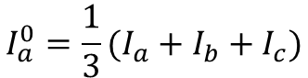
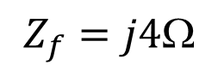
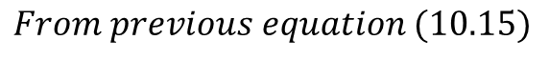
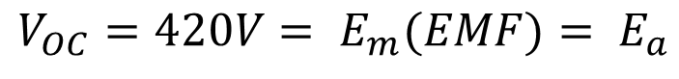
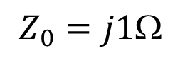
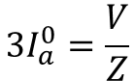




Q: A three phase generator with an open circuit voltage of 420 V is subjected to an LG fault through a fault impedance of j4 Ω. Determine the fault current if Z₁ = j6Ω, Z₂ = j3 Ω and Z₀ = j1 Ω . Also find the fault current if it is LL and LLG fault.
$$From previous equation (10.15)$$
$$V_{OC}=420V= E_{m}(EMF)= E_{a}$$
$$I_{a}^{0}=\frac{1}{3}(I_{a}+I_{b}+I_{c})$$
$$Z_{f}=j4$$
$${3I}_{a}^{0}=\left(I_{a}+I_{b}+I_{c}\right) zero sequence$$
$$Z_{1}=j6$$
$${3I}_{a}^{0}=I_{T}$$
$${3I}_{a}^{0}=\frac{V}{Z}$$
$$Z_{2}=j3$$
$$Z_{0}=j1$$

Slide 20



